Slide 1
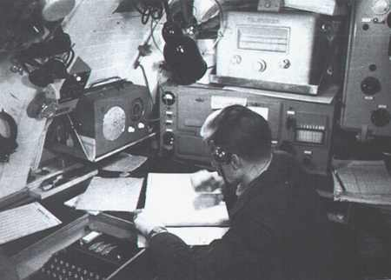
U-boat Radio Room
Personnel - Equipment - Procedures
Captain Jerry Mason, USN (ret.) VE7YAB
U-boat Archive Website http://uboatarchive.net

Slide 2
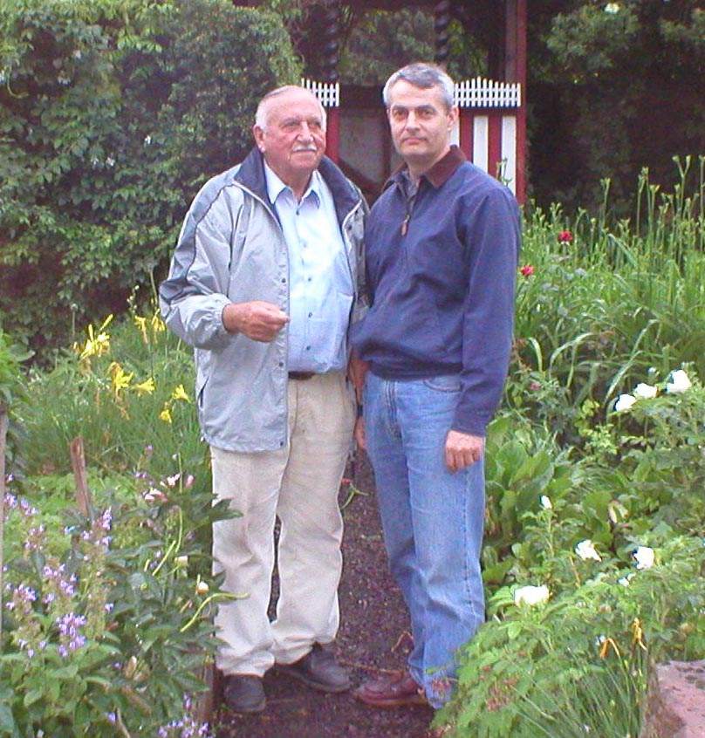
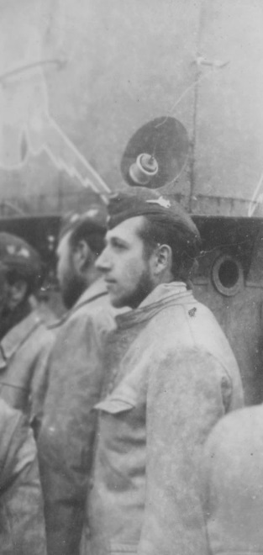
Oberfunkmaat Georg Seitz
17 years old - tobacco farmer to radioman in 17 months
U-604 – 6 patrols 6 Jan 42 to sinking 11 Aug 43
U-873 – 1 patrol 1 Mar 44 to surrender 8 May 45

Slide 3
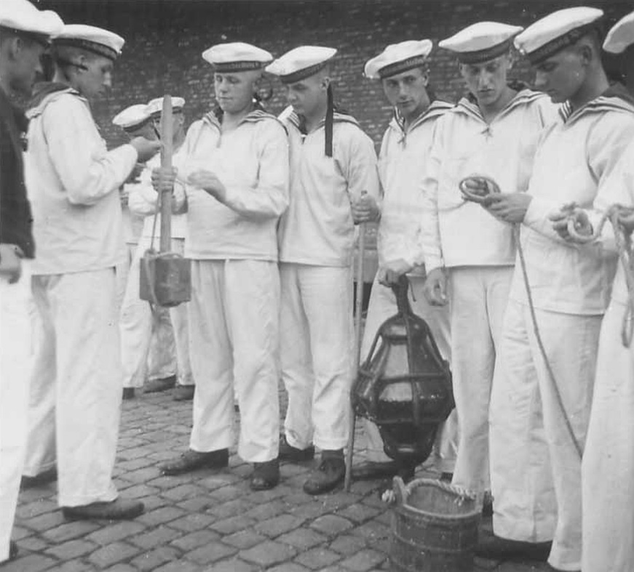
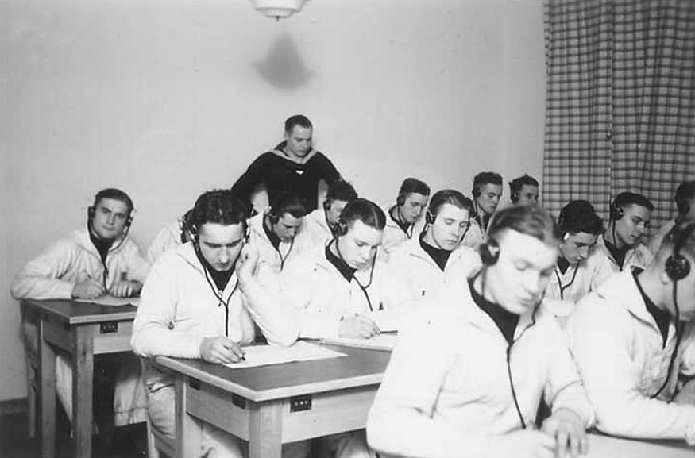
Training
Basic military training Schiffsstammabteilung 5 months
General signals training Marine-Nachrichtenschule, Aurich 3 months
General U-boat training Unterseeboot-Lehrdivision, Gotenhafen 3 months
U-boat Radio Course Unterseeboot-Lehrdivision, Gotenhafen 3 months
Special courses Hydrophone, Radar detection, Medical 3 months
17 months

Slide 4
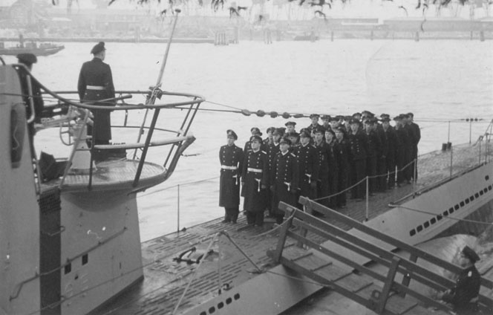
Manning
All type boats 1939-1943 2 Funkmaat (Petty Officer 2nd and 3rd Class)
      2 Funker (Radio Operator Seaman)
Large boats IXD2 and XIV 1 Oberfunkmeister (1st Class Petty Officer or a Chief)
1944-1945 2 - 3 additional Funker to operate additional gear
Occasional guests Radio intercept, meteorology personnel, test and evaluation
Second Watch Officer served as Communications Officer
Typical U-boat Crew 1942
Captain 1
First Watch Officer 1
Second Watch Officer 1
Engineering Officer 1
Navigator 1
E-machinists 8
D-Machinists 12
Radiomen 2
Torpedomen 2
Seamen 15
Total 44

Slide 5
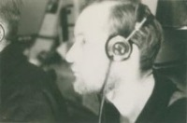
Watchstanding
Two men on duty at all times - 12 hours duty in 24 hours
Day three 4-hour watches 08.00 – 12.00
      12.00 – 16.00
  16.00 – 20-00
Night two 6-hour watches 20.00 – 02.00
02.00 – 08.00
Surfaced - Assigned HF radio circuit monitored continuously
- Allied distress frequencies 600 and 36 meters
- Radar detectors
- News broadcasts/entertainment
Submerged - G.H.G. sonar monitored continuously
- VLF radio circuit monitored continuously
- Maintenance

Slide 6
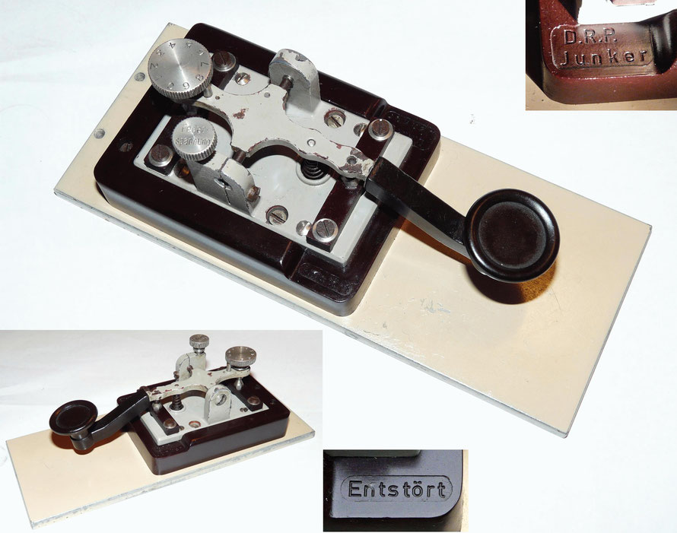
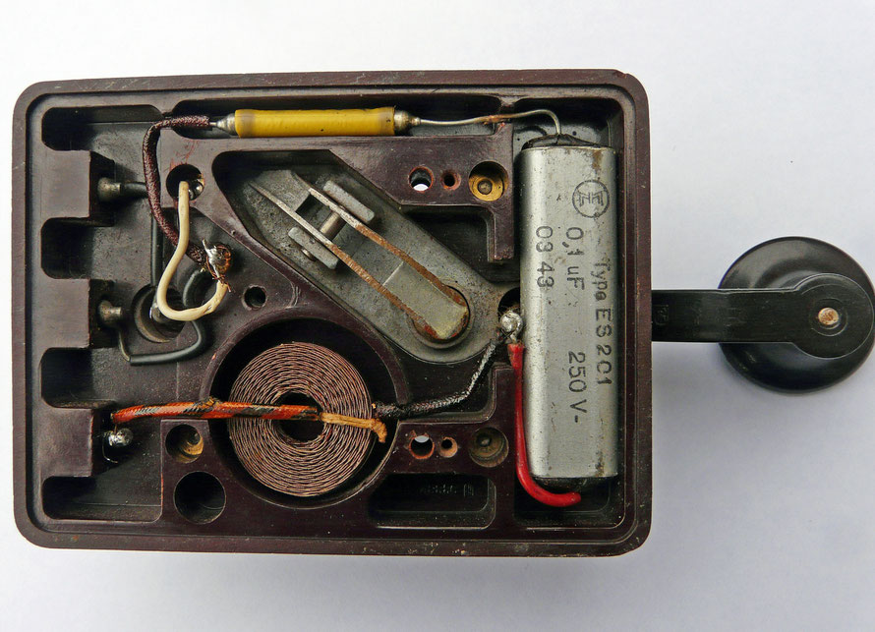
Frequency Spectrum
German Frequency Band Wavelength (metres) Allied Equiv.
Längstwelle Very long wave Below 100 kc/s 100000-10000 VLF 3-30 kHz
Langwelle Long wave 100-1,500 kc/s 10000-1000 LF 30-300 kHz
Grenzwelle Intermediate wave 1,500-3,000 kc/s 1000-100 MF 300-3000 kHz
Kurzwelle Short wave 3,000-30,000 kc/s 100-10 HF 3-30 MHz
Ultrakurzwelle Very short wave Above 30,000 kc/s 10-1 VHF 30-300 MHz
Standard Junker straight key - Morsetaste
Joseph Junker company 1926 Berlin
Weight 1 kg – base was standard
Coil and capacitor spark suppression filter

Slide 7
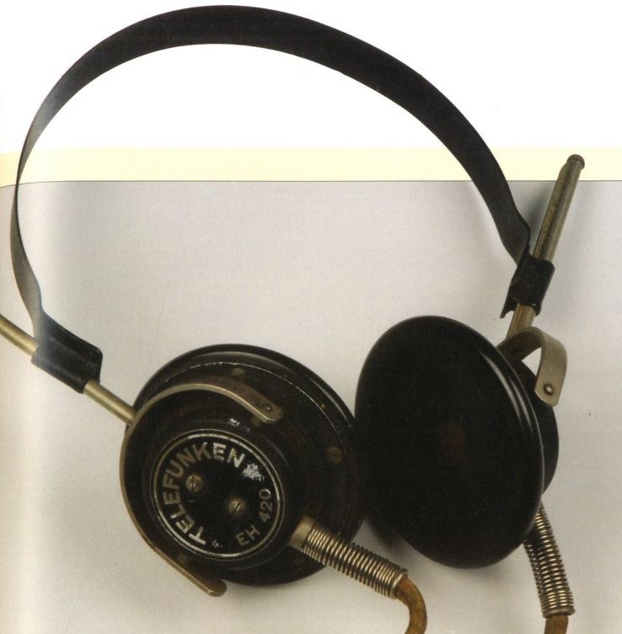
Phonetic Alphabet
German WWII Phonetic Alphabet
A Anton E Emil K Karl P Paula V Victor
Ä Ärger F Fritz L Lucie Q Quatsch W Wilhelm
B Bruno G Gustav M Max R Richard X Xanthippe
C Cäsar H Heinz N Nanni S Sophie Y Ysop
Ch -arlotte I Ida O Otto T Toni Z Zet or Zeppelin
D Dora J Jot Ö Öse U Ulrich Sch -ule
Additional Greek Letters for special purposes
A Alpha B Beta Γ Gamma
Δ Delta E Episilon Λ Lambda Φ Pi
Standard Telefunken EH 420 headset used on U-boats
- 2 x 2000 ohms

Slide 8
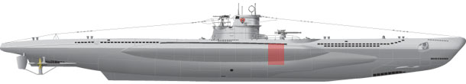
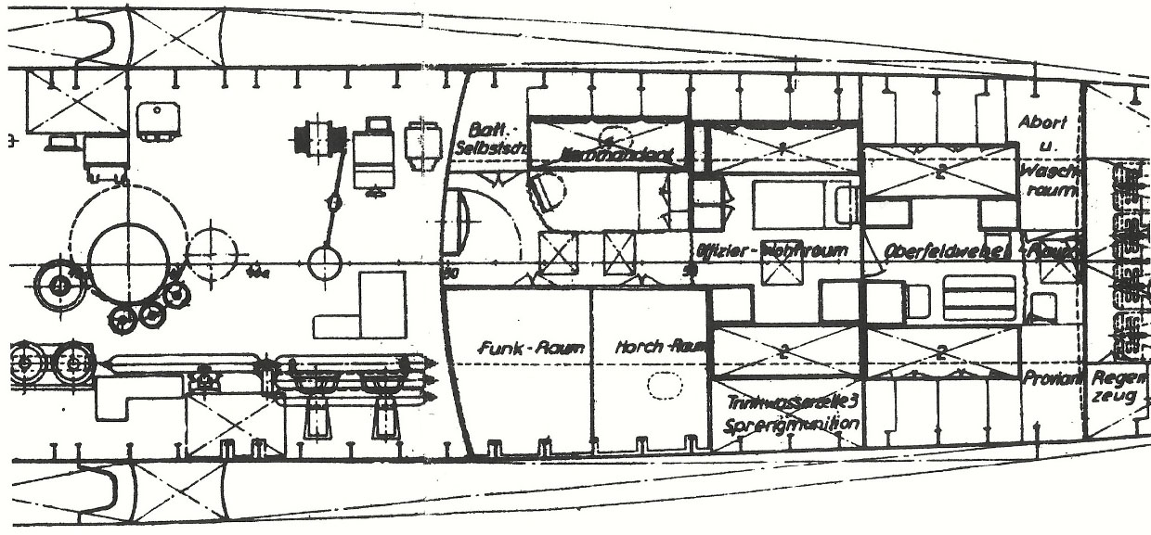
Location of the Radio Room
Radio and Sound room floor area 3.2 m², 2 m² respectively
Formed of wooden partitions and secured by wooden doors
Communication by voice tubes to the control room
Pass through between radio and sound rooms

Slide 9
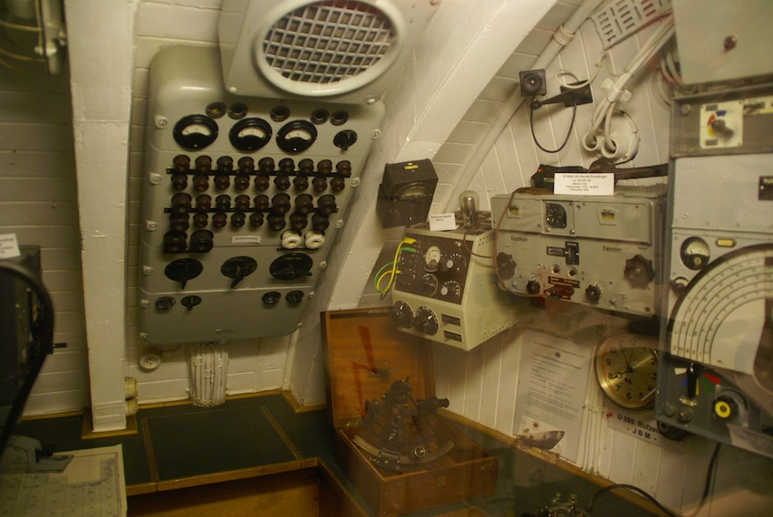
Layout of the Radio Room
U-995 Radio Room (display boat in Laboe outside Kiel, Germany)

Slide 10
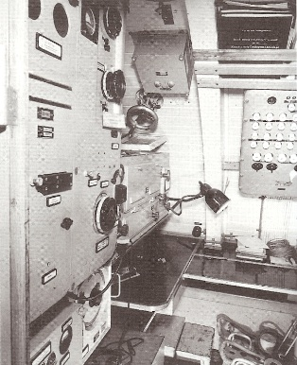
Layout of the Radio Room
Typical contents of the radio room
200 watt HF transmitter
150 watt MF beacon transmitter
LF Antenna coupler
HF receiver
VHF/LF receiver (DF receiver)
Antenna selection panel
Standard controller
Radar equipment
Various power supplies
Power control/fuse panel
Enigma machine
Code books and manuals
Public address system
Broadcast receiver
Radione broadcast receiver
Phonograph
U-889 Radio Room after surrender

Slide 11
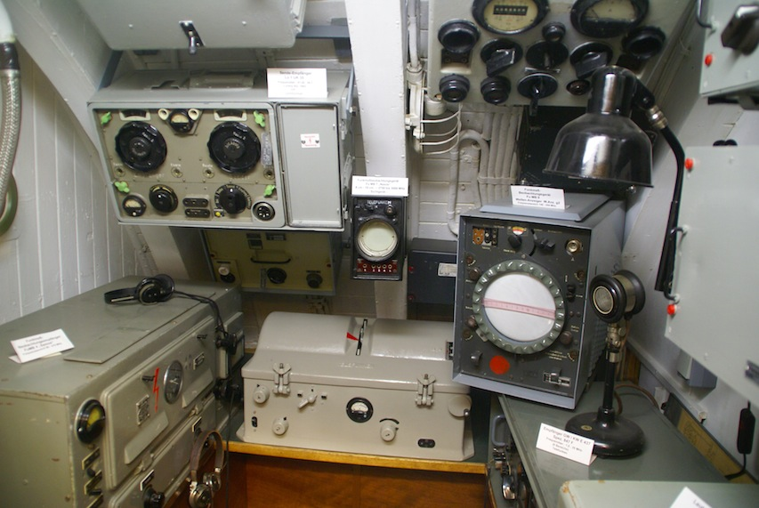
Layout of the Sound Room
U-995 Sound Room

Slide 12
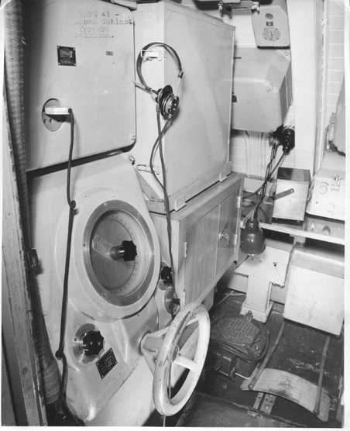
Layout of the Sound Room
Typical contents of the sound room
GHG Hydrophone
KDB Hydrophone (early war boats)
Underwater Telegraph (CW, 3.5 kc/s, 5 nm)
Lorenz 40 watt backup HF transmitter
All-wave receiver (Backup HF receiver)
VHF transceiver (late war boats)
Radar detection equipment
Various power supplies
Any special/experimental gear for guests
U-889 Sound Room

Slide 13
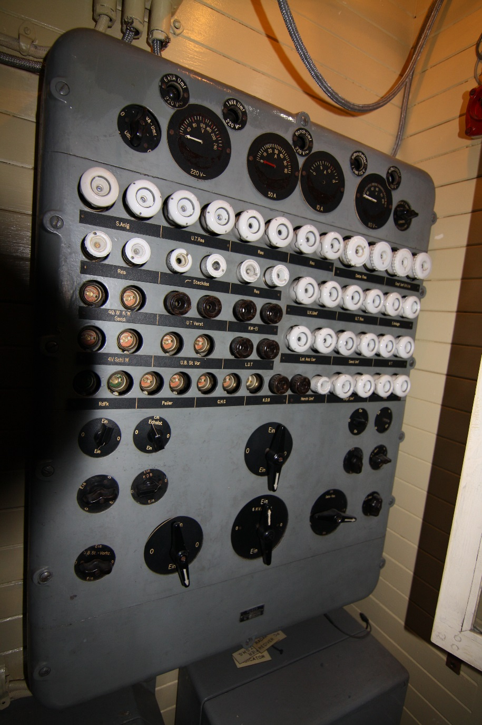
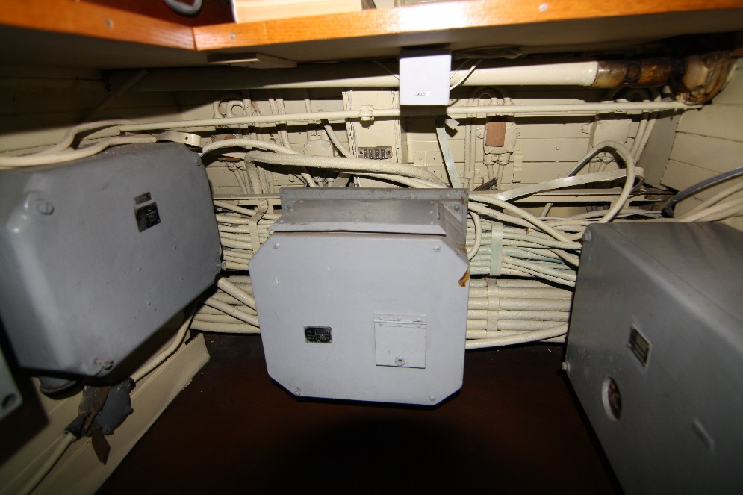
Power Distribution
Motor generator sets in the E-motor room converted 110 V DC to 220 V AC 50-60 c/s
Primary set 6 kVA, backup 1 kVA
Panel controlled all power exclusive of lighting - 110 V DC and 220 V AC
Each radio had its own power supply
- transformers provided regulated AC
- rectifiers provided DC

Slide 14
U-boat Transmitters and Receivers
Transmitters Frequency Power Primary use Comment
Telefunken S406 S/36 3.75–15 MHz 200 W Primary HF Tx.
Telefunken T200FK39 3–24 MHz 200 W
Lorenz Lo40K39 3–16.7 MHz 40 W Backup HF Tx.
Telefunken Spez 2113 300–600 kHz 150 W Beacon MF Tx.
Lorenz Lo10UK39 37.8–48 MHz 10 W VHF Transceiver Workups later
Lorenz Lo1UK35 41.55–45.75 MHz 10 W VHF Transceiver comm. intercept
Receivers Frequency Primary Use Comment
Telefunken E437 S 1.5–25 MHz Primary HF Rec. “Breadbox”
Telefunken T9K39 1.5–25 MHz “Main”
Telefunken E52 1.5–25 MHz “Köln”
Telefunken E436 S 75 kHz–1.5 MHz Early war Rec.
Telefunken E381 S 15 kHz–20 MHz Backup HF/VLF Rec. All wave Rec.
Telefunken T3PLLä38-2 15–33 kHz/70–1200 kHz Beacon MF & VLF Rec.
Telefunken E 405 N 15–33 kHz/65–1667 kHz Navy modified EP2
Telefunken ELA 1012 145 kHz–21.8 MHz Broadcast Rec.
Radione R2 150 kHz–22.2 MHz Broadcast Rec. Entertainment

Slide 15
U-505 Transmitters and Receivers
Transmitters Frequency Power Primary use Comment
Telefunken S406 S/36 3.75–15 MHz 200 W Primary Tx.
Lorenz Lo40K39 3–16.7 MHz 40 W Backup Tx.
Telefunken Spez 2113 300–600 kHz 150 W Beacon Tx.
Lorenz Lo10UK39 37.8–48 MHz 10 W VHF Transceiver Comm. Intercept
Receivers Frequency Primary Use Comment
Telefunken T9K39 1.5–25 MHz Primary Rec. “Main”
Telefunken E381 S 15 kHz–20 MHz Backup Rec. All wave Rec.
Telefunken T3PLLä38-2 15–33 kHz/70–1,200 kHz Beacon & VLF Rec.
Telefunken ELA 1012 145 kHz–21.8 MHz Broadcast Rec.
Radione R2 150 kHz–22.2 MHz Broadcast Rec. Entertainment
Red = missing today Green = present today

Slide 16
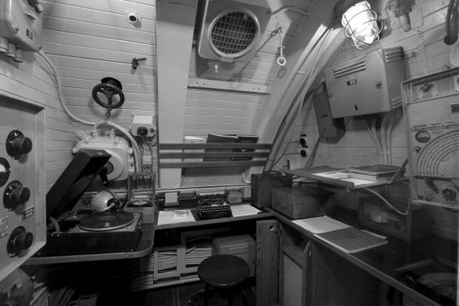
U-505 Radio Room Today
Missing at right: ELA 1012 Broadcast receiver, T9K39 primary HF receiver
Missing center: Public address system amplifier/control panel
Missing at left: Underwater telegraph amplifier/control unit, Standard Controller,
Spez 2113 beacon transmitter, S406 S/36 main HF transmitter and power supply

Slide 17
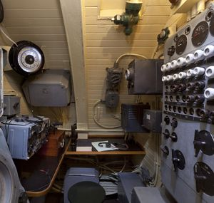
U-505 Sound Room Today
Missing at right: Lo40K39 back up HF transmitter,
Missing center: E381 S all wave receiver
FuMB 7 Naxos, FuMB 9 Wanze, FuMB 10 Borkum radar receivers

Slide 18
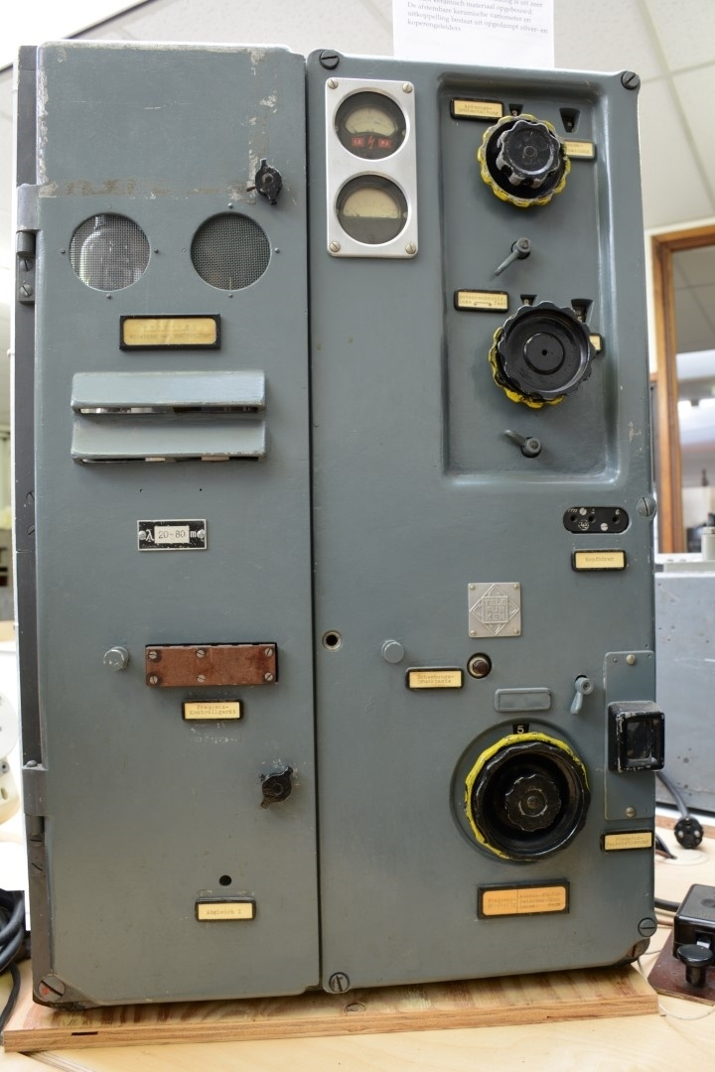
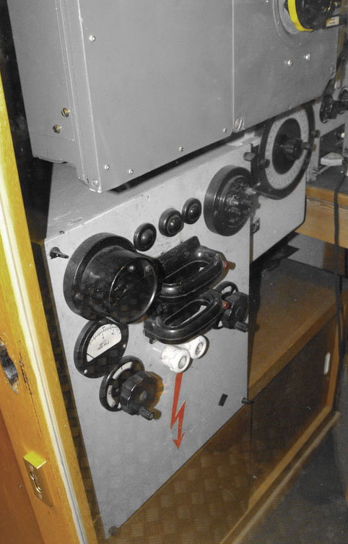
Telefunken S 406 S2/36 Transmitter
Size: 50 cm wide x 77 cm high x 45 cm deep
Power: 200 W Weight: 90 kg
Frequency Range: 3.75-15 MHz
Valve lineup: 2 REN 904 (exciter)
2 RS 288 (splitting stage)
2 RS 291 (PA)
1 RGN 1064
Power: 220 V AC
Year: 1936
Power supply unit contained a motor generator provided 400 V & 1500 V DC to both the HF and MF transmitter

Slide 19
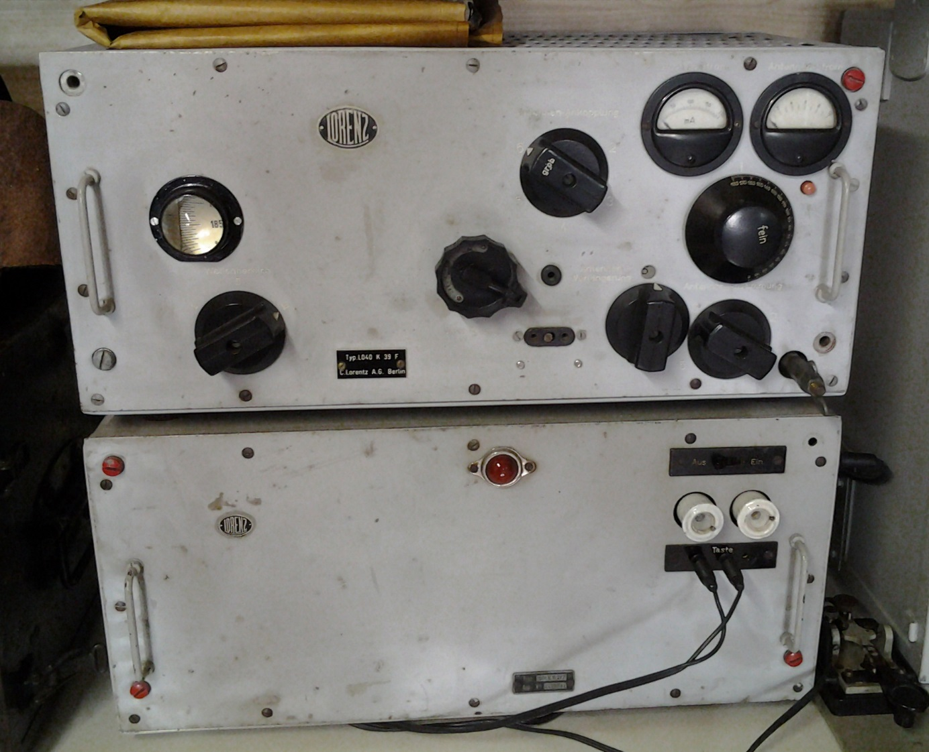
Lorenz Lo40K39 Transmitter
Size: 55 cm wide x 60 cm high x 30 cm deep
Weight: Tx. 35.4 kg
+ Pw. 38.5 kg = 73.9 kg
Power: 40 W
Frequency Range: 3-16.7 MHz
Valve lineup: 3 RL12P35
Power: 220 V AC
Year: 1939

Slide 20
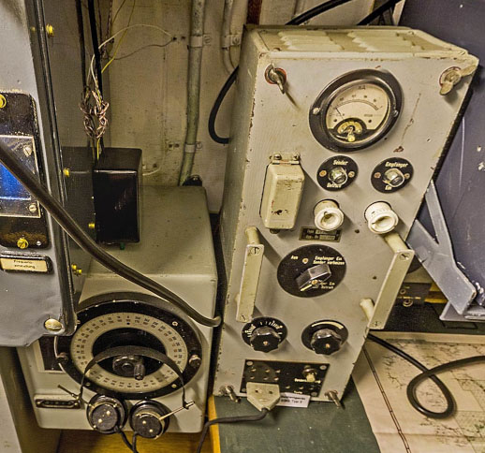
Telefunken Spez 2113 Beacon Transmitter
Size: 28 cm wide x 33 cm high x 28 cm deep Weight: about 11 kg
Power: 150 W Modulation: A1
Frequency Range: 300-600 kHz
Valve lineup: 1 RL12P35, 2 RS291
Power: 220 V AC Year: 1935
Beacon signals were hand keyed CW Morse
typically VVVV + coded position of the boat
relative to the convoy
Unit to the right of the Spez 2113 is a
Standard control unit which worked
between the receivers and transmitters
Keyed HF and MF transmitters remotely
Generated side tone
Cut out receivers when transmitting

Slide 21
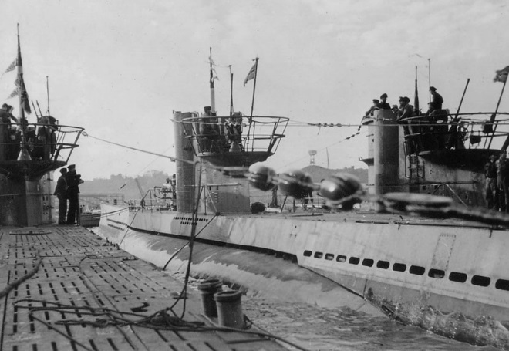
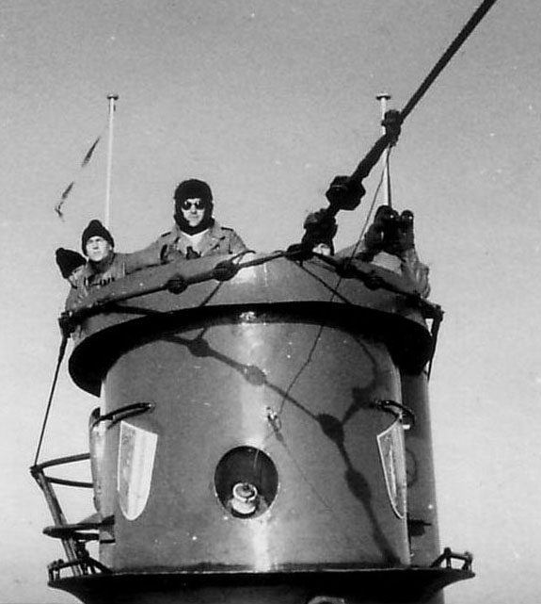
HF/MF Antennas
12.5 mm galvanized steel wire – 14 meters forward, 16 meters aft
Used to transmit and receive HF radio messages and transmit MF bearing signals
Generally forward antenna transmitted, after antennas received
If possible the boat was pointed 90° to the receiving station
Emergency antennas
  Bare copper wire strung over the raised periscope or Aphrodite radar decoy balloon
  Runddipol Fu.M.B. antenna atop the snorkel / DF sensing element antenna

Slide 22
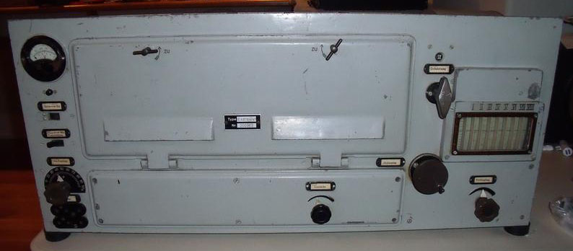
Telefunken E437 S Receiver
Size: 77 cm wide x 36 cm high x 30 cm deep Weight: 45 kg
Reception principle: TRF with reaction (regenerative); 1 AF stage
Frequency Range: 1.5-25 MHz Modulation: A1 and A2 (CW and tone CW)
Wave Bands: 6 AM circuits, short wave Power: 220 V AC
Tubes: 5 RENS1284
Year: 1934

Slide 23
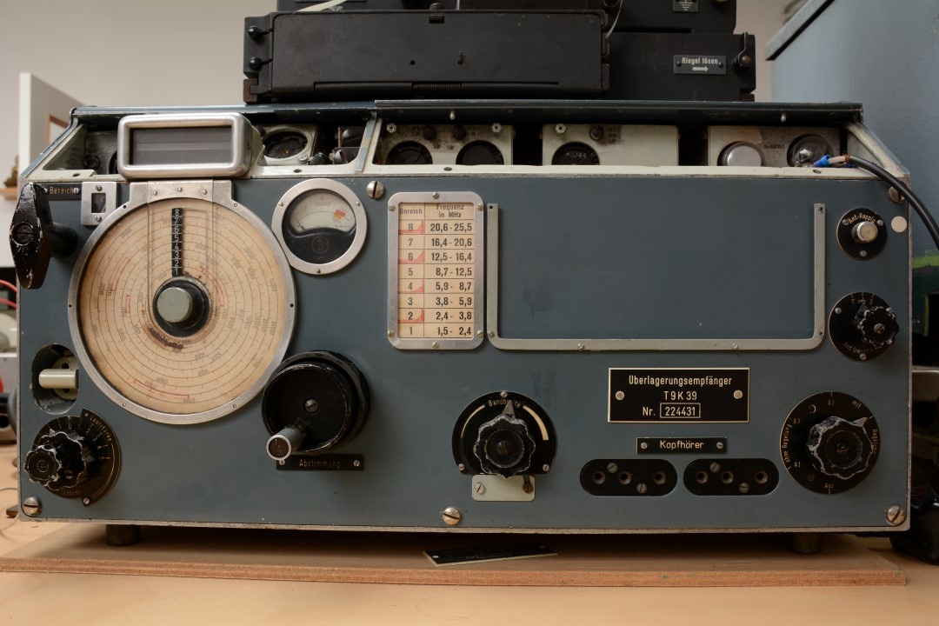
Telefunken T9K39 Main Receiver
Size: 55 cm wide x 33 cm high x 29.5 cm deep Weight: 45 kg
Reception principle: Superhet with RF-stage; ZF/IF 1875 kHz
Frequency Range: 1.5-25 MHz Modulation: A1, A2 A3
Tuned circuits: 9 AM circuits, Wave Bands short wave (SW Only)
Tubes: 3x RV12P2001
7x RV12P2000
1x SV100/25Z
134-42 Glow Lamp
Power: 220 V AC
Year: 1939

Slide 24
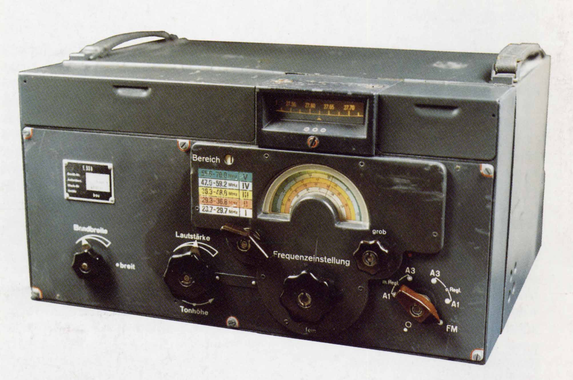
Telefunken E52 “Köln” Receiver
Size: 44.5 cm wide x 24.5 cm high x 35 cm deep Weight: 41 kg
Reception principle: Superhet with RF-stage; ZF/IF 1000 kHz 2 AF Stages
Frequency Range: 1.5-25 MHz Modulation: AM/CW with BFO
Wave Bands Broadcast plus 2 short wave bands
Tubes: 12: RV12P2000
RG12D60
Power: 220 V AC
Year: 1941

Slide 25
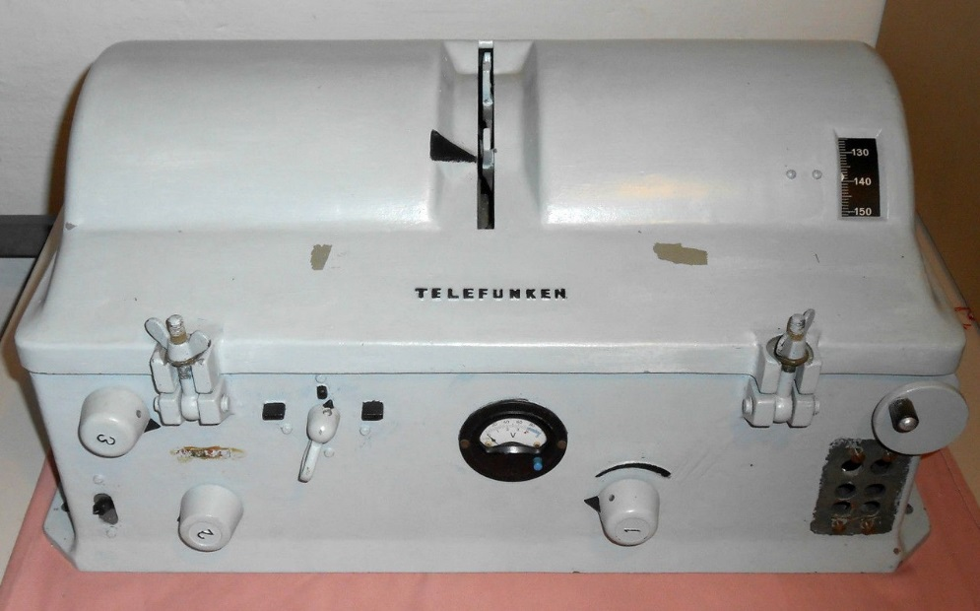
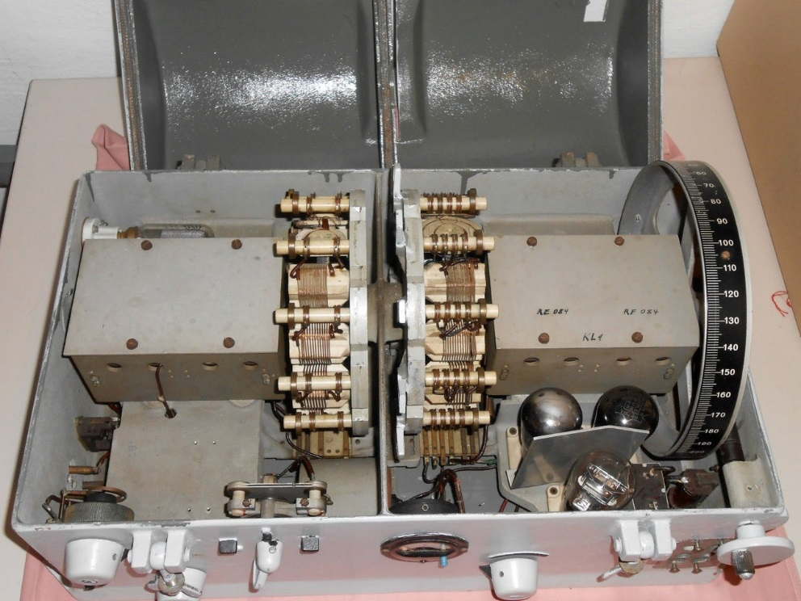
Telefunken E381S Receiver
Size: 57 cm wide x 27 cm high x 35 cm deep
Weight: 20 kg
Reception principle: TRF with reaction
Tuned circuits 2 AM circuits
Frequency Range: 14.6 kHz to 20 MHz
Valve lineup: RES094 (RF), 3 x RE084 (detector, audio and output stages)
Power: +4V 0.35A, +100V 20 mA
Year: 1932

Slide 26
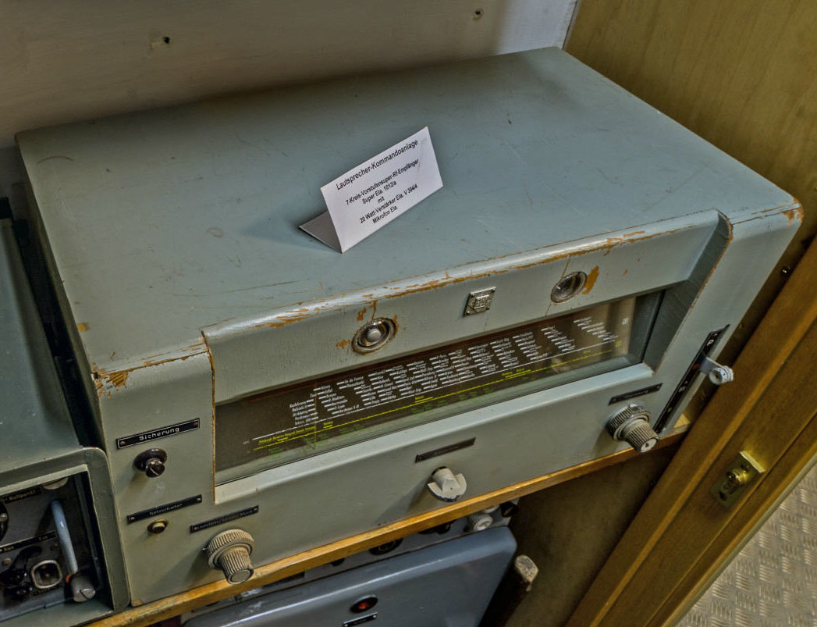
Telefunken Ela 1012 Broadcast Receiver
Size: 58 cm wide x 30 cm high x 33 cm deep
Reception principle: Superhet with RF-stage, ZF/IF 468 kHz
Frequency Range: 145 kHz-21.8 MHz
Wave Bands: broadcast, long wave and 2 x short wave
Tuned circuits: 7 AM
Tubes: EF 13, ECH 11, EFB11,
EF11, EM11, EL 12, AZ12
Power: 220 V
Tuning: Magic eye
Case: Wooden

Slide 27
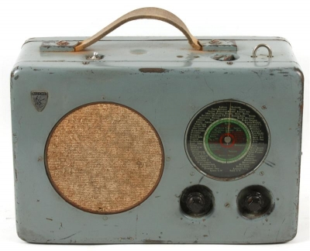
Radione R2 Broadcast Receiver
Size: 35 cm wide x 23.5 cm high x 17.5 cm deep
Reception principle: Superhet with RF-stage, ZF/IF 469.5 kHz
Frequency Range: 145 kHz-21.8 MHz
Wave Bands: Broadcast, short wave, medium wave, long wave
Tuned circuits: 7 AM
Tubes: EF13, ECH11, EF12, EBC11
EDD11, EZ11
Power: 220 V or 12V DC Battery
Year: 1939

Slide 28
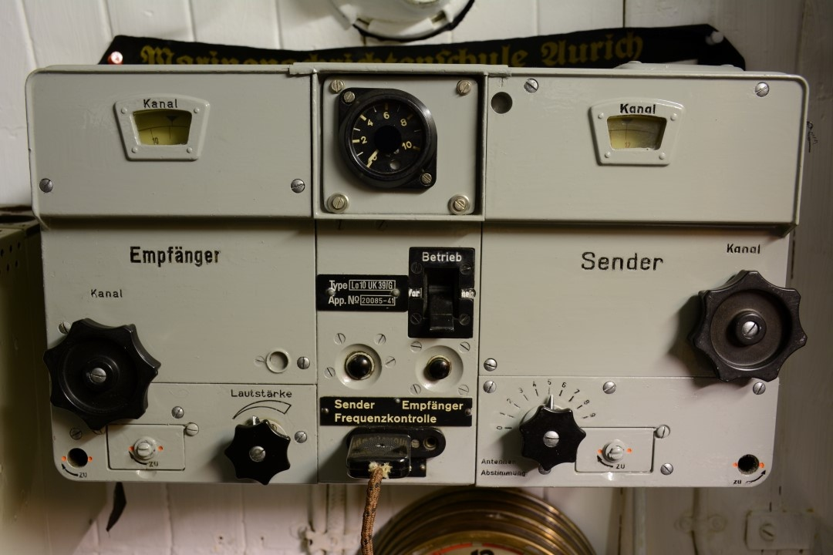
Lorenz Lo10UK39 VHF Transceiver
Size: 37.4 cm wide x 22 cm high x 20.8 cm deep Weight: 13.8 kg
Modulation: Transceiver, ZF/IF 6000 kHz, 1 AF stage A2 and A3 (toned CW and AM)
Frequency Range: 37.4-45.8 MHz (VHF) 18 channels 10W transmitter
Wave Bands: VHF 18 channels
Tubes: Tx. 2 RL12P35
Rx. 9 RV12P2000
Cont. 3 RV12P2000
Power: 220 V
Year: 1939

Slide 29
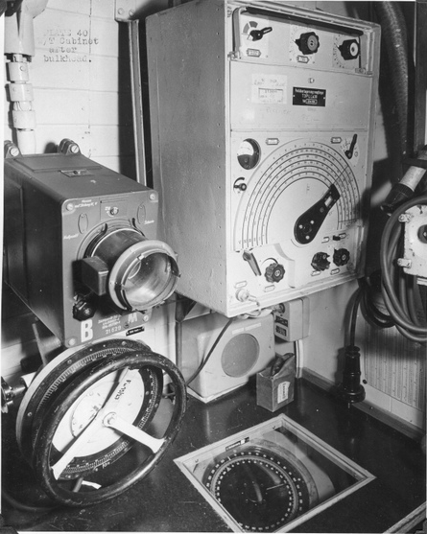
Telefunken T3PLLä38 Receiver
Size: 15 cm wide x 15 cm high x 18 cm deep
Weight: 25 kg
Frequency Range: 15-33 kHz/70-1,200 kHz
Tubes: 3 RES094, 3 REO84K
Power: 240 V AC
DF antenna was steered by hand wheel from below the counter
Steering unit incorporated a gyro compass repeater
Year: 1938

Slide 30
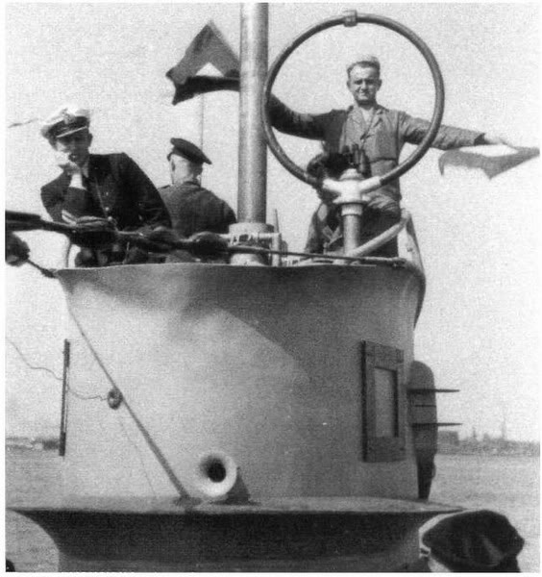
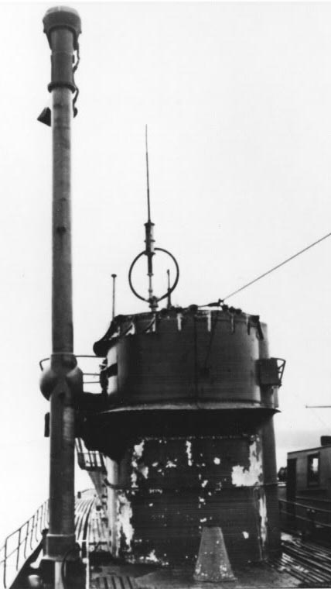
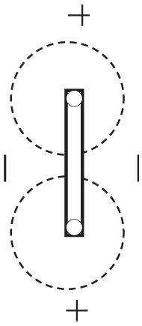
DF Loop Antenna (HF/MF/VLF)
800 mm in diameter – raised by compressed air
Turned by mechanical linkage from the radio room
Used primarily for MF direction finding (surfaced) and VLF radio message reception (submerged) – secondarily for HF broadcast reception (surfaced)
Pressure-proof shielded loop antenna - null position used for direction finding
Late war boats carried a direction sensing rod antenna mounted on the loop.

Slide 31
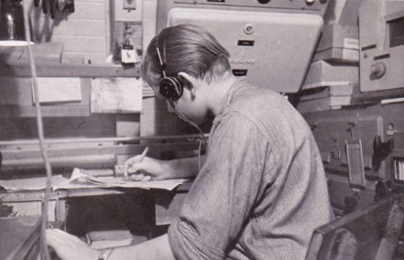
U-boat Radio Circuits
Area circuits
Communications for a specific geographic area
Frequencies optimized for day and night reception
CW Morse at 20-25 words per minute
3 or more frequencies keyed simultaneously
Messages numbered sequentially
Transmitted on HF and repeated on HF and VLF
Program time - Tagesappell & Vortagesappell
Circuit name Area Serial Nos.
Coastal North Sea, Channel and Biscay area 1-100
Ireland Greenland-Ireland area 101-200
America I Eastern North Atlantic 201-300
America II Western North Atlantic 301-400
America III Central Atlantic & Caribbean 401-500
Africa I South Atlantic 501-600
Africa II Indian Ocean 601-700
Nordmeer I & II Northern Norway and Arctic 601-700 & 701-800
Mediterranean Western Mediterranean
Aegean Eastern Mediterranean
Penang Indian Ocean

Slide 32
Africa I & II Circuit
00-01 01-02 02-03 03-04 05-06 06-07 07-08 08-09 09-10 10-11 11-12
12-13 13-14 14-15 15-16 16-17 17-18 18-19 20-21 21-22 22-23 23-24
Africa I
Africa II
ra 38.24 m - 7845 kHz
cb 27.73 m - 18,818 kHz
cg 21.79 m - 13,767 kHz
so 19.16 m - 15,655 kHz
iq 15.45 m - 19,420 kHz
cg 21.79 m - 13,767 kHz
Program Times
0500 – 0600 Tagesappell 0900 – 1000 “
1130 – 1200 “
1700 – 1800 “
2300 – 0100 Vortagesappell
Control Station Villecresnes, France (near Paris)
VLF: Bordeaux: 19,150 m – 16.66 kHz
Backup Paris I: 19,710 m – 15.22 kHz
Serial Nos. 401 - 500
Established for Group Eisbär (U 68, U 156, U 172, U 504 and refueler U-459) for an attack on Capetown, South Africa in September/October 1942

Slide 33
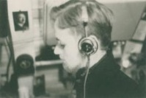
U-boat Radio Circuits
Convoy Circuits
Used to provide communications for a specific U-boat Group
Diana – Channel and Biscay area
Hubertus – Eastern North Atlantic
Wotan – Eastern North Atlantic
Other Circuits
Used by surface ships and U-boats as an alternative to the assigned circuit
4 frequencies keyed simultaneously
Bruno 3/Norddeich – Worldwide coverage
Anton/Kootwijk – Eastern North Atlantic and Northern Norway

Slide 34
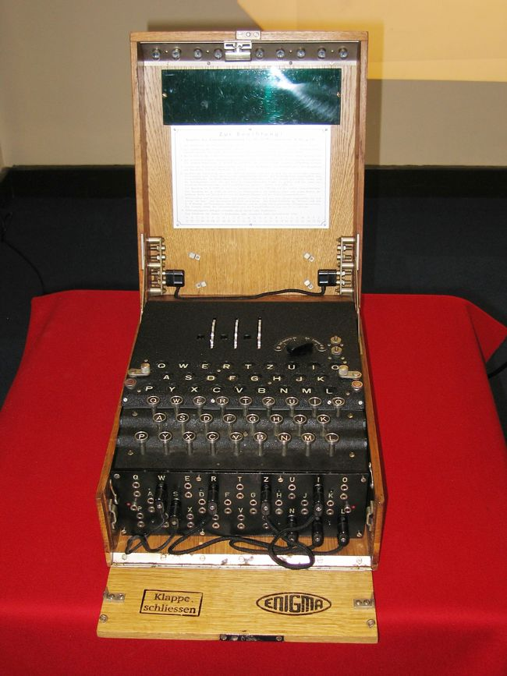
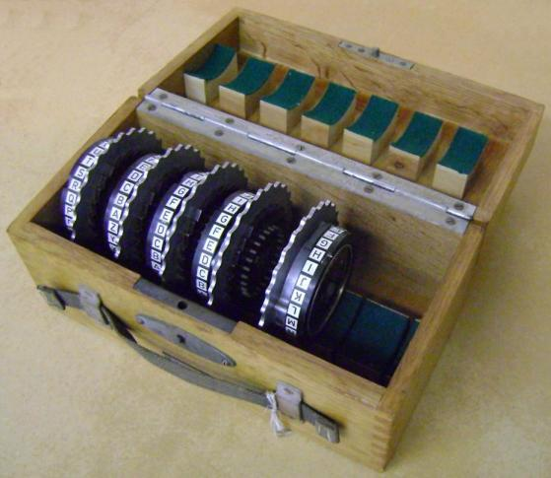
Enigma Machine
German Navy bought Enigma in 1926
Keyboard with only 26 letters – no numbers
3 of 5 rotors were changed daily along with their ring settings and start positions (4 of 8 rotors after 1942) + 1 of two reflectors
Each press of a key advanced the rotors 1 step
Plug board used 10 cables switching 20 of 26 letters
Pressing a key sent a current through the plug board – the rotors – the reflector – the rotors – plug board and then lit a bulb
In practice 10²³ possible key settings
Naval Enigma remained unbroken until 1941 when the Short Signal weather code book was captured from U-110

Slide 35
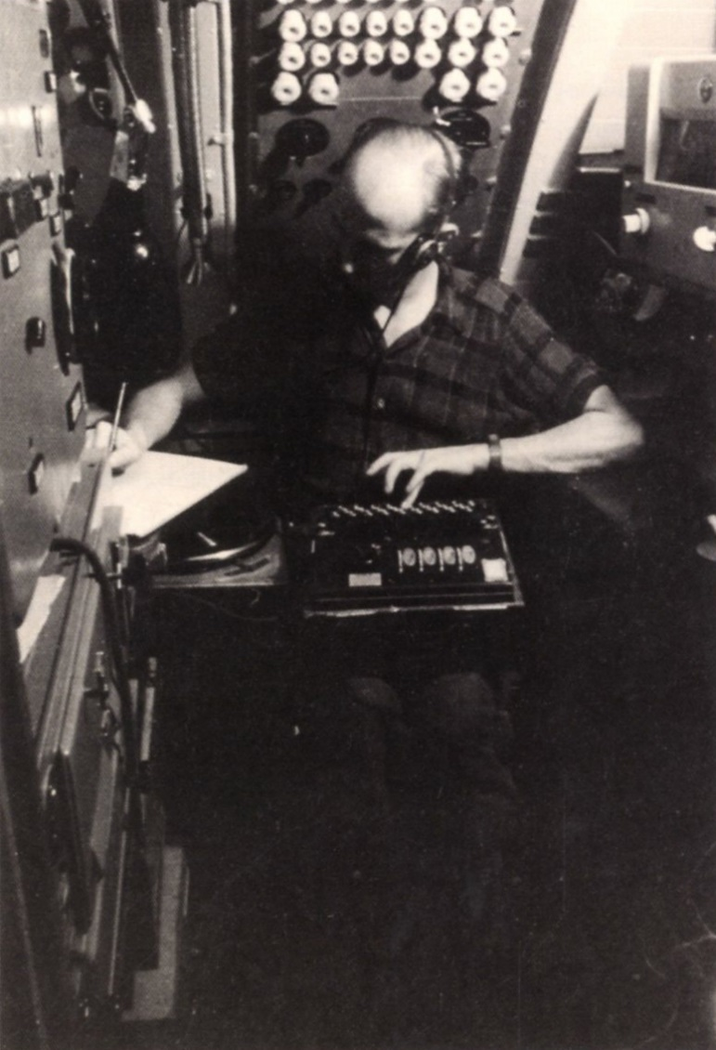
Preparing a Message
!!! Greatly Simplified !!!
Consult the code books - set the ring setting in each rotor, install them in the in the specified order and set up the plug board
Choose two trigrams - for example YPX and TMK
Set the rotor start position to YPX
Type TMK and get the “encrypted message key” FZQ
Change rotors to the second trigram TMK and encode the text
Create the message header:
1830 1 1 52 YPX FZQ
time # parts part # # characters start pos. key
To decode the shore station set up his Enigma machine
Used the first trigram YPX as start position
Typed the second trigram FZQ and got the message key TMK
Set his machine to start position TMK and decoded

Slide 36
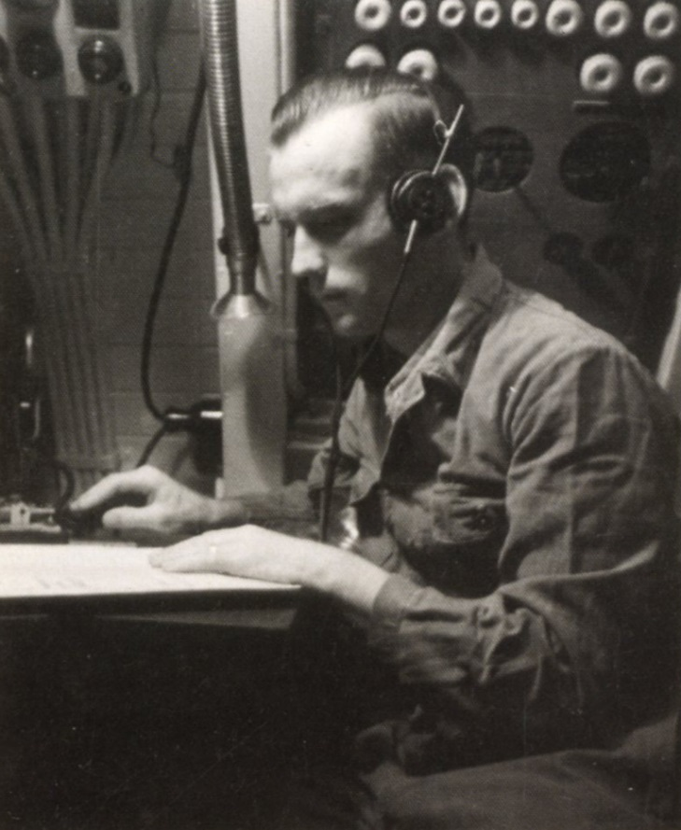
Sending a Radio Message
U-boat listened to the various frequencies of the assigned circuit and picked the best signal
If the message was important enough the U-boat could interrupt the Shore Station Program time or wait until the normal times for U-boat transmission.
U-boat sent CQ (Short Signals used AA or BB for operational and WW for weather signals)
Shore operator replied K for OK proceed
The U-boat then transmitted:
1830 1 1 52 YPX FZQ Header with message key
BEHD JENT LAIE NKFT JGHQ ALIC BEIF
HALF ORNH KANX KRNE EKAN IJEK Encoded text
SK End of message
If received clearly the shore operator repeated it during the next time reserved for shore to sea transmission adding the Serial No.

Slide 37

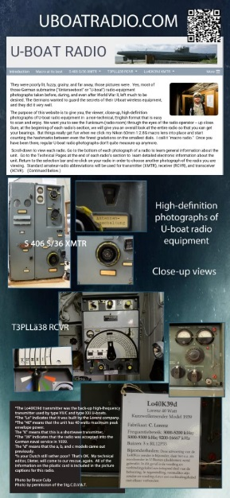
More Information
Download an Enigma simulator and send coded messages
Close up high definition photos of U-boat Radios and more
Both these websites are operated by fellow Ham Bruce Culp - N7CLH
http://www.enigmaworldcodegroup.com
http://www.uboatradio.com

Slide 38
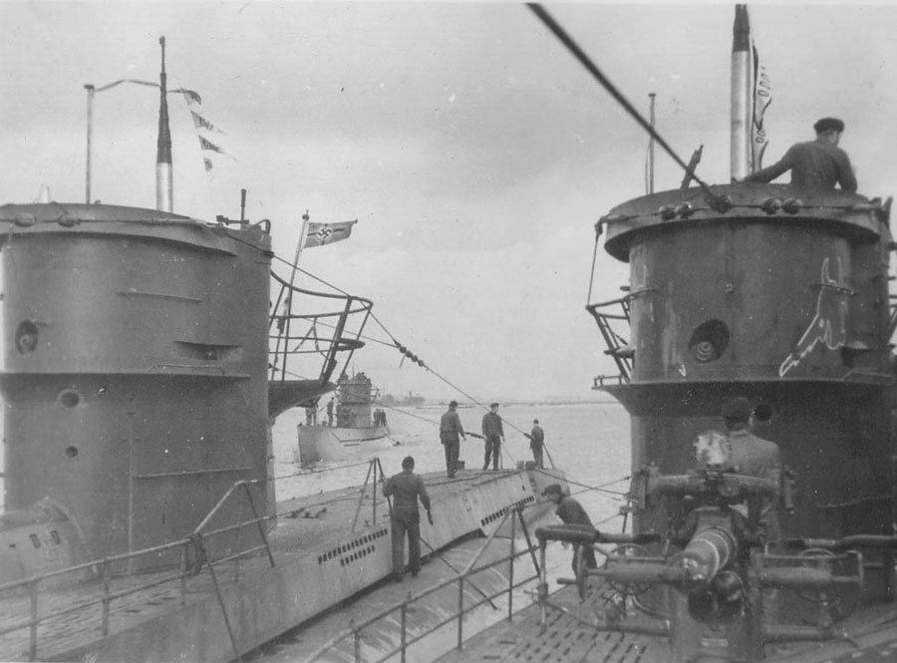
The End
U-604 returns from patrol 5 November 1942 after operations against convoy SL 125

